Slide 1
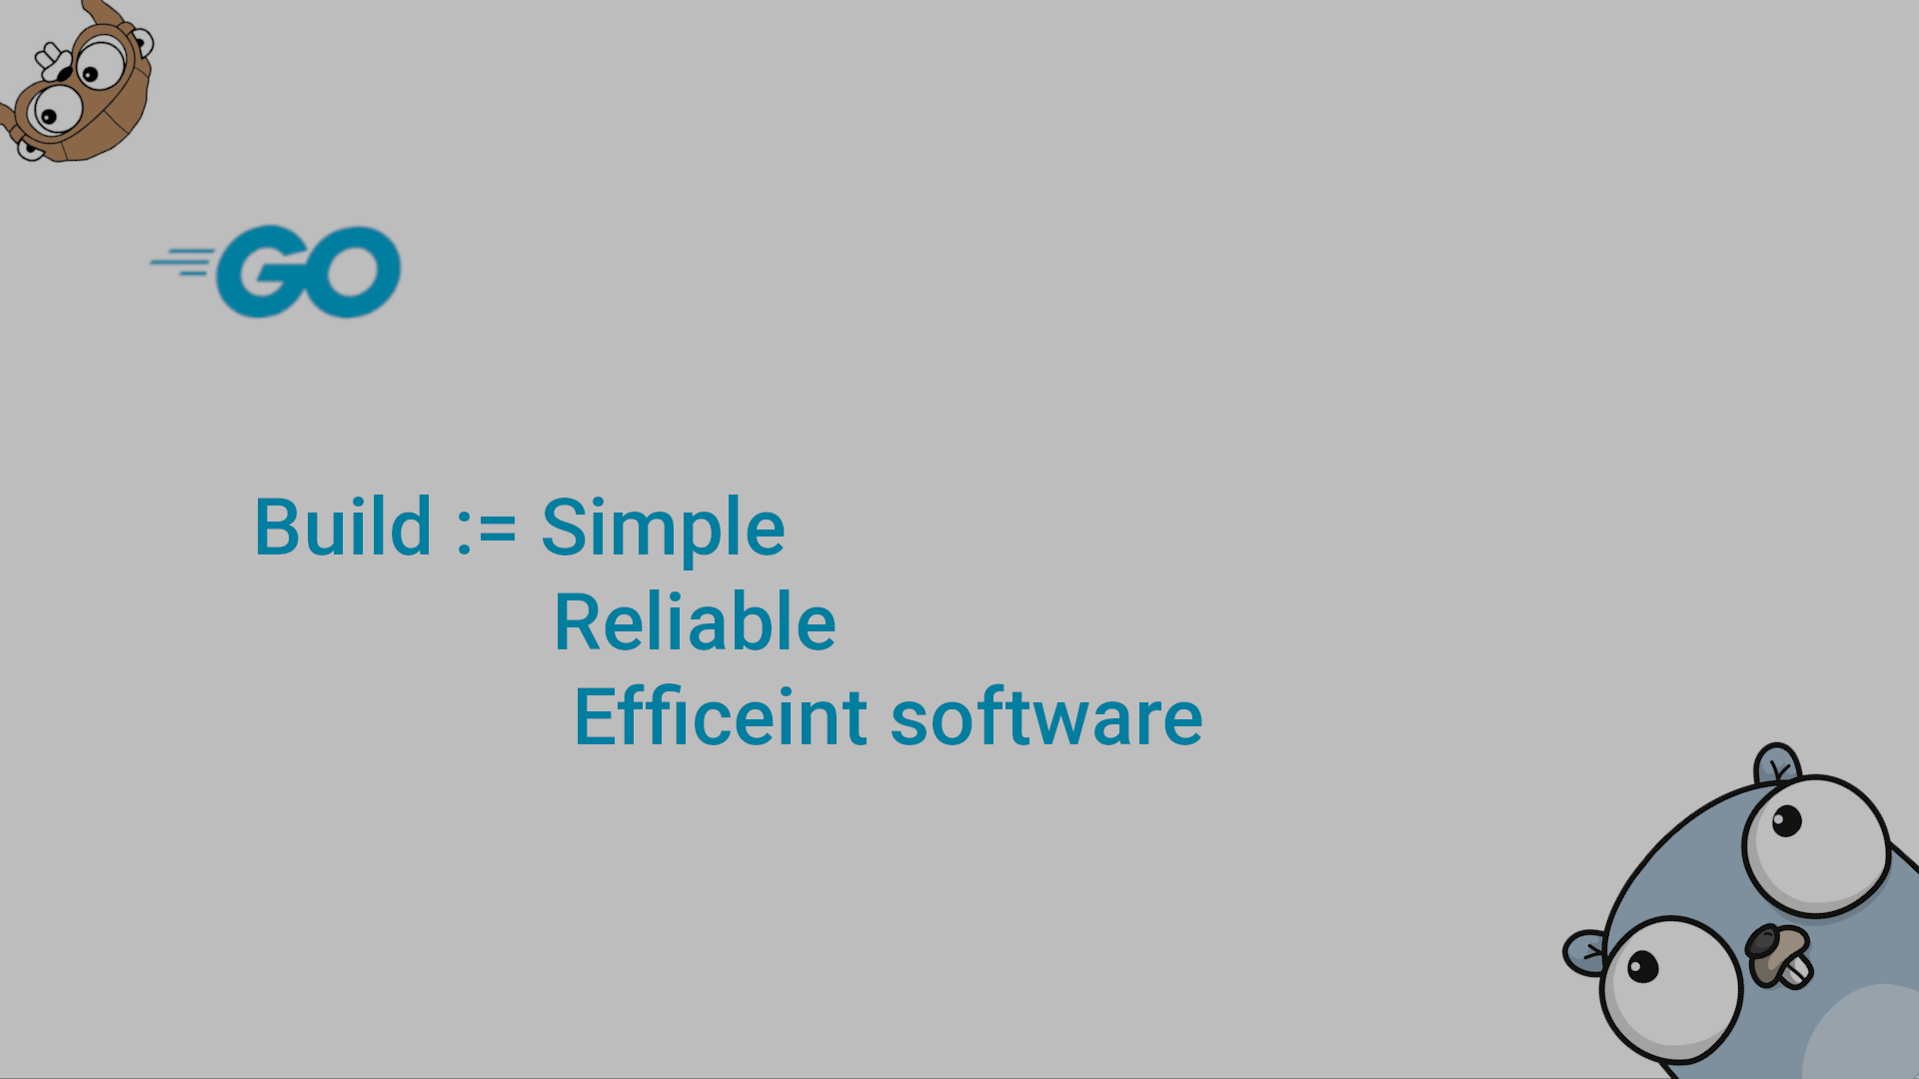
Go Fundamentals Part II

Slide 2
What Are Data Structures?
The greatest room for variability in algorithm design is generally in the way in which the data of the program is stored.
Any variable is defined with a type, which could be a simple one like integers (holds one value), or could be a data structure (a collection of elements), both of which are called Abstract Data Type (ADT).
Type is a set of values and a set of operations on those values [Mathematical Definition]. ADT is a data type that is accessed only through an interface (Accessing mechanisms).
The ADT has two views:
User/Client View: the one who uses the implemented interface
Implementation View: the one who creates the ADT and implements the interface that the user uses.
Implementation is composed of two major steps:
a) Type Definition (where you create a new shape and properties of the memory)
b) Interface (Accessing mechanism) implementation (make sure that it meets the user preferences).
=> Usually, the interface is a set of methods [Initialize, Insert, retrieve/delete, GetSize, isEmpty, isFull, clear ]

Slide 3
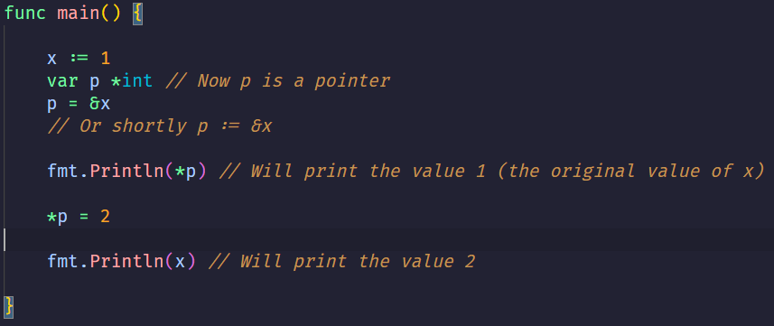
What Are Data Structures? (Pointers)
Since type is a memory location, we can further decompose it into two more pieces based on the value it holds: value types or reference types. Pointers are reference type.
A pointer value is the address of a variable. A pointer is thus the location at which a value is stored. Not every value has an address, but every variable does
Go provides you the type *int, but do you know how it’s implemented? No, this is called Information Hiding (Encapsulation), the main property of ADTs. Thus, you infer that this piece of code is just you using the interface of the pointer type (you are the user level here) *** If you create a new ADT, make sure you hide something ***

Slide 4
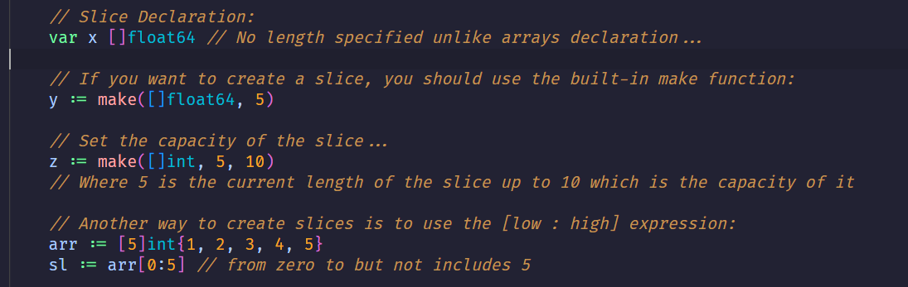
The Go Slices:
A slice is a segment of an array. Like arrays, slices are indexable and have a length. Unlike arrays, this length is allowed to change

Slide 5
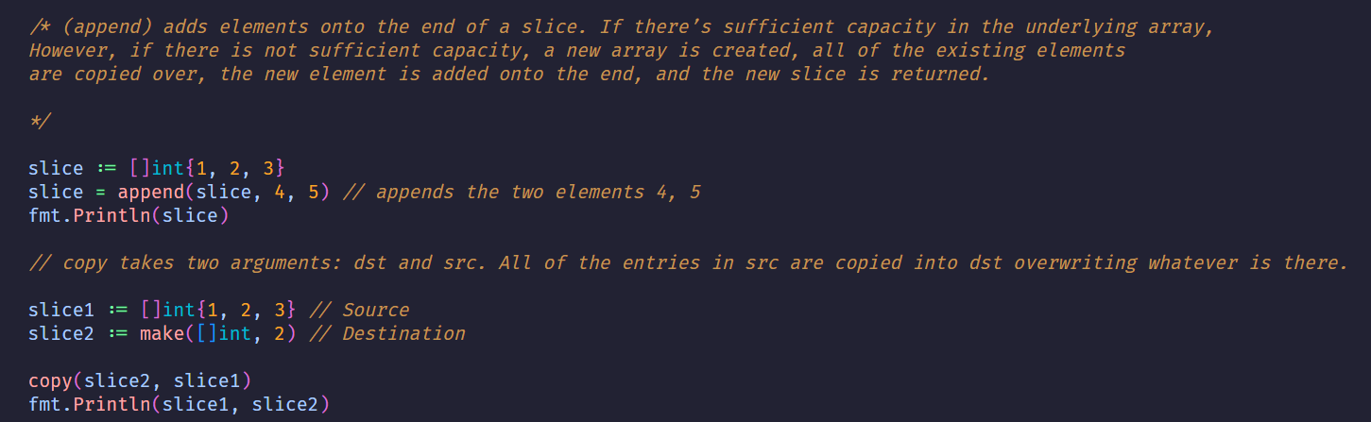
The Go Slices:

Slide 6
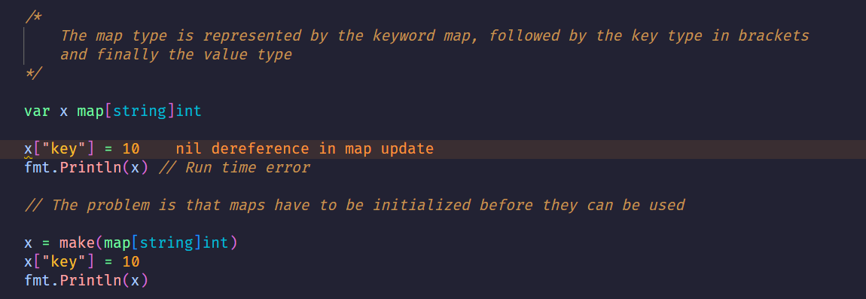
The Go Maps:
A map is an unordered collection of key-value pairs (also called associative arrays, hash tables, or dictionaries).

Slide 7
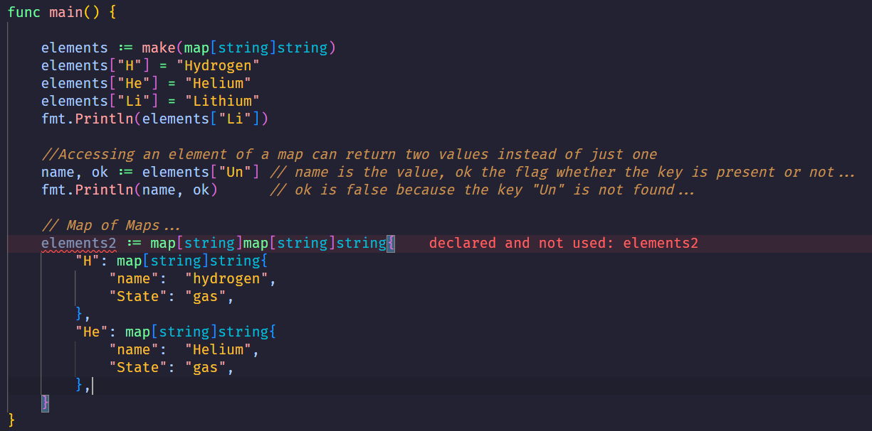
The Go Maps:

Slide 8
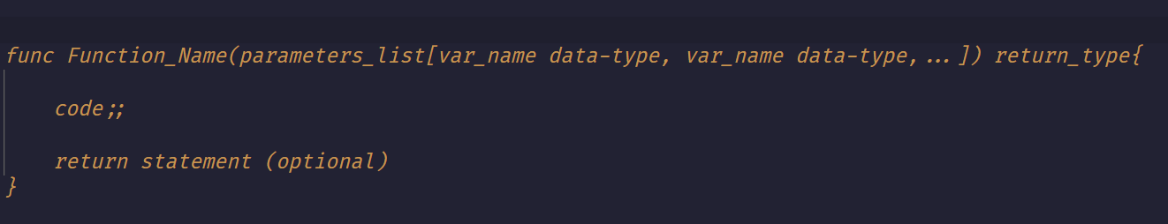
The Go Functions:
A function (also known as a procedure or a subroutine) is an independent section of code that maps zero or more input parameters to zero or more output parameters.
Functions start with the keyword func, followed by the function’s name. The parameters (inputs) of the function are defined like this: name type, name type

Slide 9
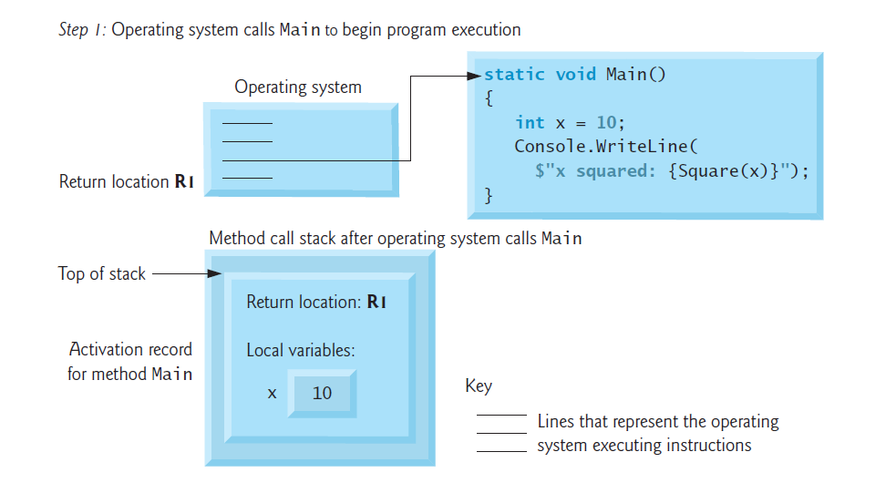
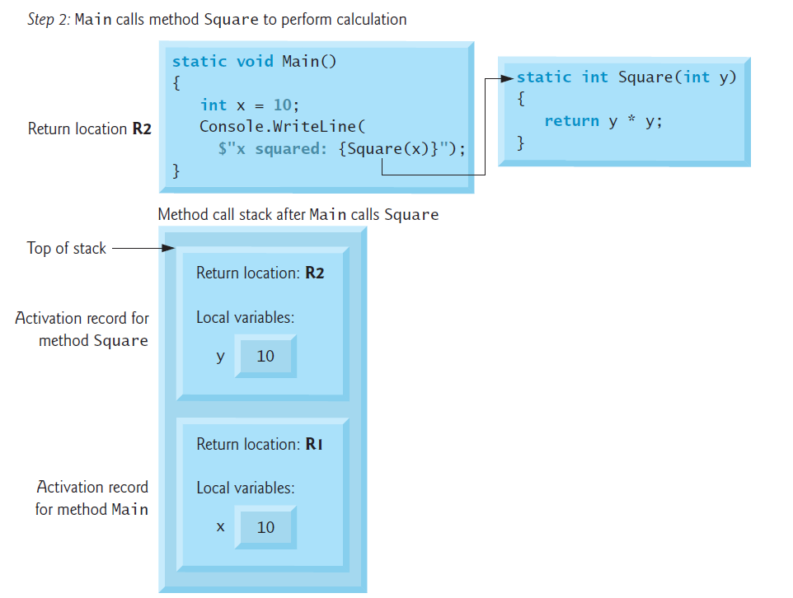
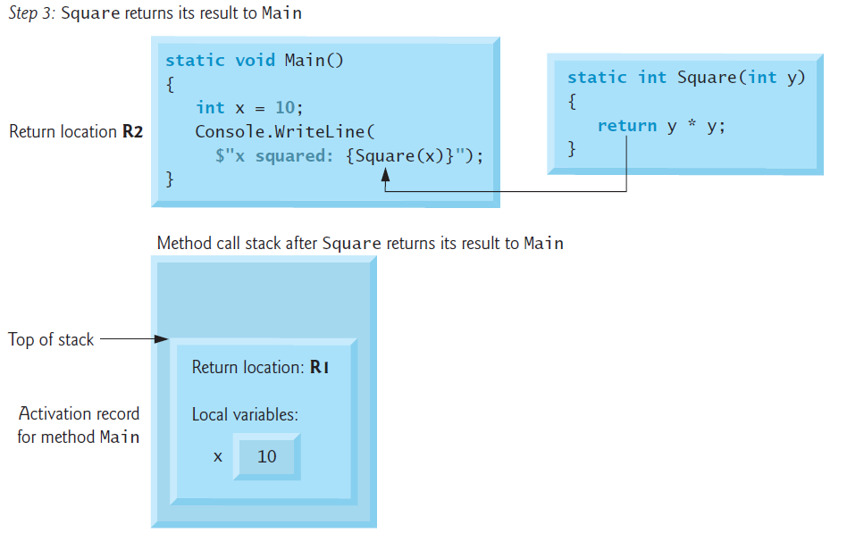
The Go Functions:

Slide 10
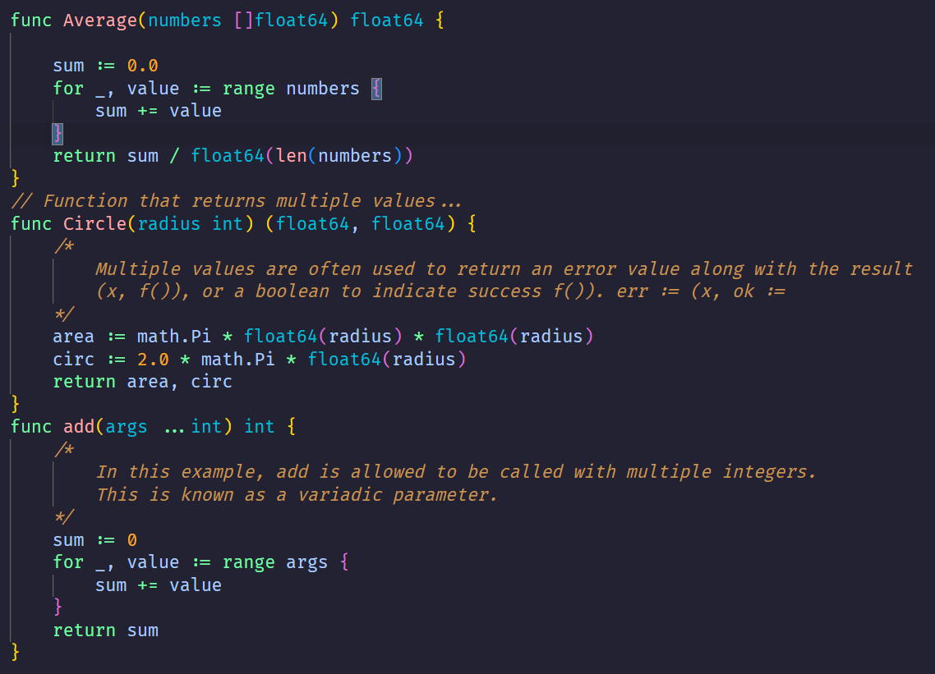
The Go Functions:
By using an ellipsis (...) before the type name of the last parameter, you can indicate that it takes zero or more of those parameters. In this case, we take zero or more ints. We invoke the function like any other function except we can pass as many ints as we want.

Slide 11
Exercises:
Implement the Matrix operations: Sum, Subtract, Multiply, Apply Sigmoid, Relu, and Tanh
Dynamic Input with Slices
Task: Read integers until EOF (or until a negative number) into a [ ]int. Then: Print the slice. Print its len and cap after each append (so students can see capacity growth).
Given a sorted slice of ints nums, remove duplicates in place and return the new logical length
Given a sentence, split into words where each word maps to a slice of positions where it appears (0-based index)

Slide 12
Exercises:
Solve the sum of digits using recursion.
Write recursive IndexOf(arr []int, target int, i int) int finding first occurrence starting at index i.
Return -1 if not found. No loops allowed.
main: Test [1,3,3,2,5] searching for 3 from different start positions. IndexOf [1 3 3 2 5], target 3, start 0 -> 1 IndexOf [1 3 3 2 5], target 3, start 2 -> 2 IndexOf [1 3 3 2 5], target 4, start 0 -> -1
Solve the Fibonacci using recursion

